Slide 1
Housing Price Prediction

Slide 2
Data Source
https://www.kaggle.com/c/house-prices-advanced-regression-techniques

Slide 3
Hypothesis and Predictors
Hypothesis: Can we identify house prices based on certain characteristics
Target : House Price
Features:
Square feet
zipcode
lotsize
house style
year built
basement sq feet
garage availability
number of bedroom

Slide 4
Exploratory Analysis
We have 1460 instances and 81 features in our training data set
Common factors affecting the house prices:
Location
Bedrooms
Living square footage “sqft_living”
Basement square footage “sqft_basement”
Waterfront
Floors
Condition
zipCode

Slide 5
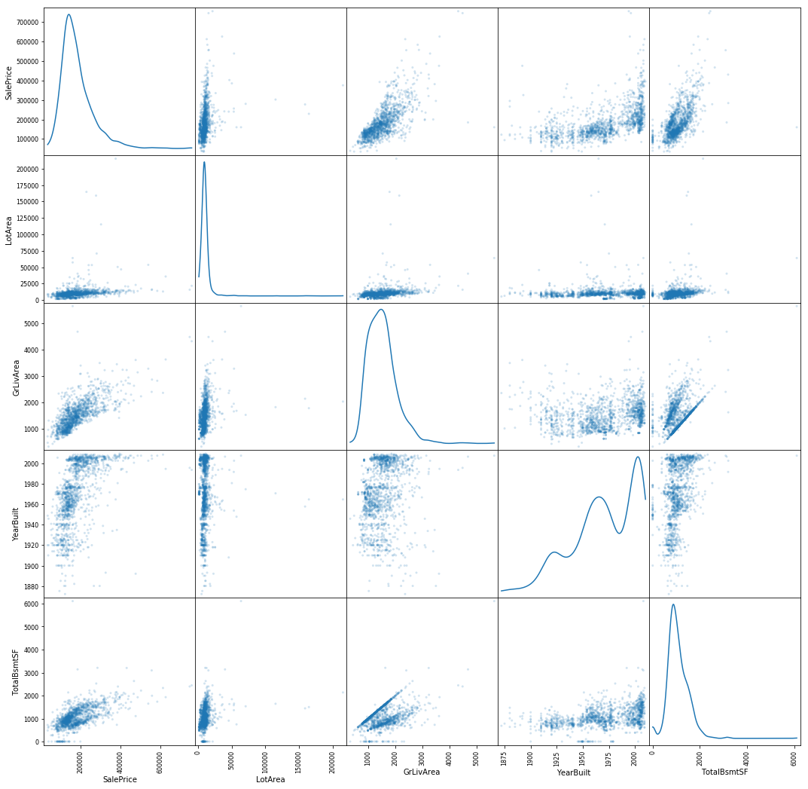

Slide 6
Data Wrangling
Addressed missing data
Remove duplicate values
Remove spaces or special characters
Converted strings to numerical representations where needed

Slide 7
Modeling
Eliminate zero (or near-zero) variance predictors : by running Regularization techniques.
Eliminate highly and correlated predictors:

Slide 8
Model Selection
Regression problem
Linear Regression
Gradient boosting algorithm

